Slide 1


“BallRun” game
Team members:
Kulakov Mykhailo
Jeonghyun Son
Shvets Volodymyr

Slide 2
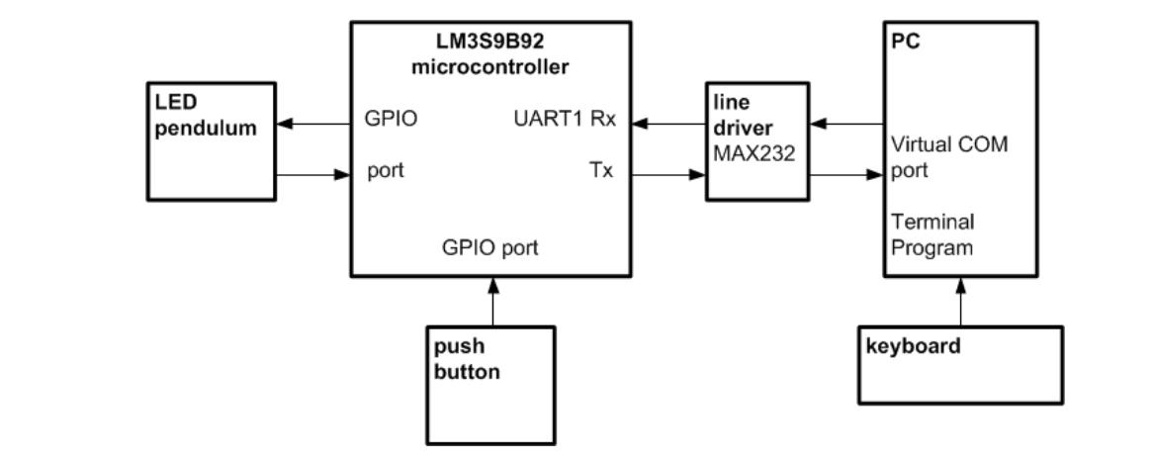
Overall block diagram

Slide 3
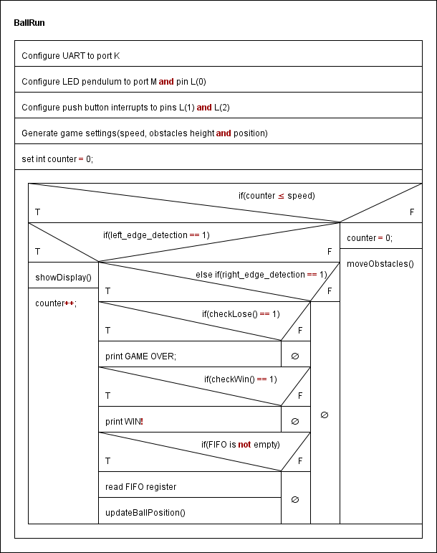

Slide 4
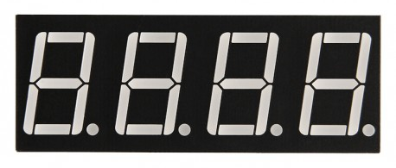



Slide 5

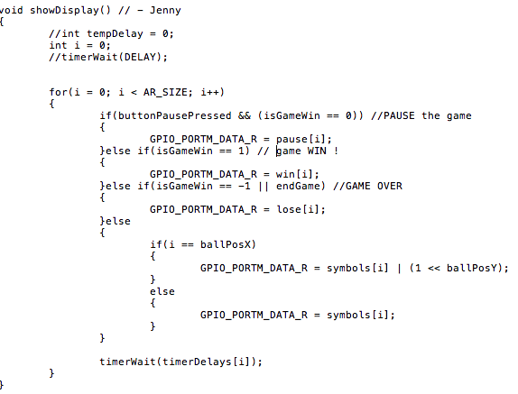



Slide 6
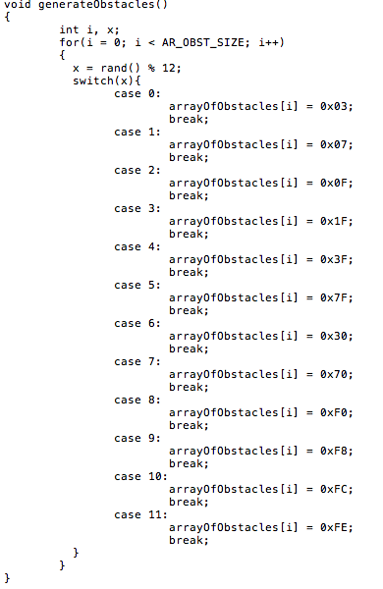


Slide 7
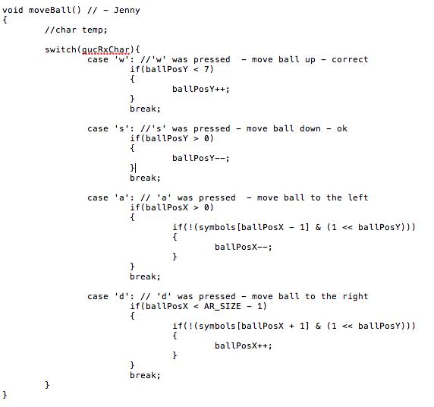


Slide 11

Interrupt handlers
UART interrupt
Push button 1 = PAUSE/CONTINUE game
Push button 2 = END/START game

Slide 12
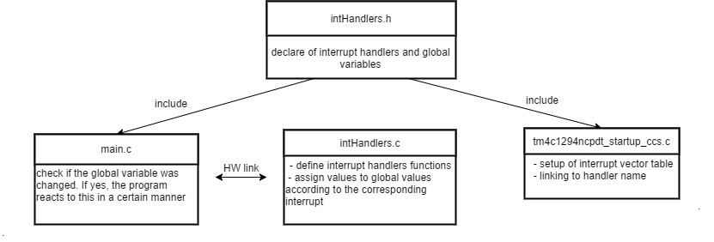
Overall interrupt concept

Slide 13
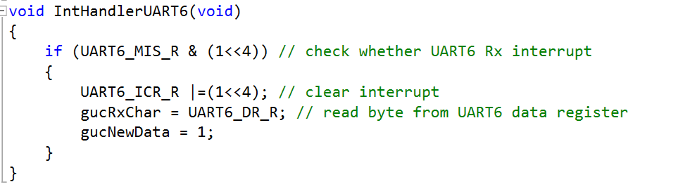
UART interrupt

Slide 14
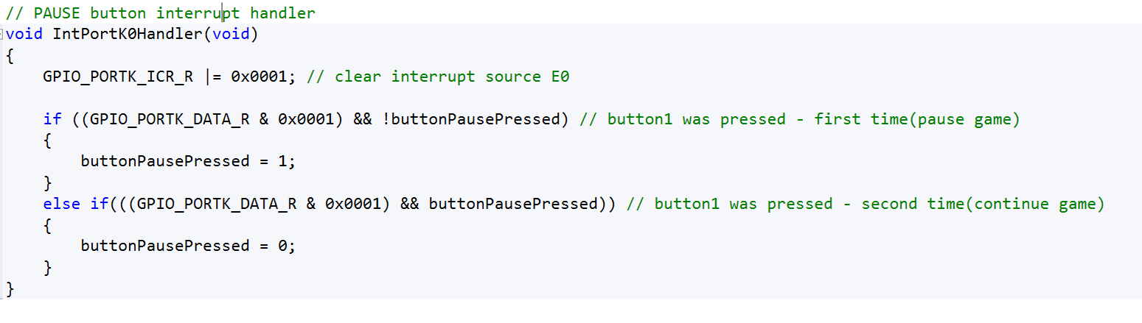
PAUSE/CONTINUE game

Slide 15
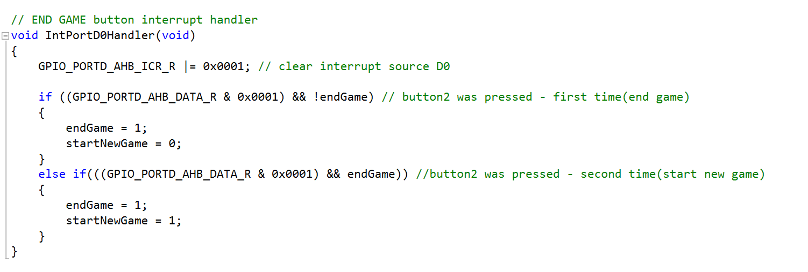
END/START game

Slide 16
Thank you for attention ☺

